Slide 1
MALIGNANT COMMENT CLASSIFIER PROJECT PRESENTATION
By: Akanksha Kaushik

Slide 2
INTRODUCTION
Over the decade social media have been growing and people are able to express their opinions and also discuss among others via these platforms.
These debates may arise due to differences in opinion and may often result in fights over the social media during which offensive language termed as malignant comments may be used from one side.
This clearly pose the threat of abuse and harassment online.
As such, some people stop giving their opinions which will result in unhealthy and biased discussion.
Therefore it result in different platform and communities finding it very difficult to facilitate fair conversation and are often forced to either limit user comments or get dissolved by shutting down user comments completely.

Slide 3

Problem Statement
The proliferation of social media enables people to express their opinions widely online. However, at the same time, this has resulted in the emergence of conflict and hate, making online environments uninviting for users. Although researchers have found that hate is a problem across multiple platforms, there is a lack of models for online hate detection.
Online hate, described as abusive language, aggression, cyberbullying, hatefulness and many others has been identified as a major threat on online social media platforms. Social media platforms are the most prominent grounds for such toxic behaviour.
There has been a remarkable increase in the cases of cyberbullying and trolls on various social media platforms. Many celebrities and influences are facing backlashes from people and have to come across hateful and offensive comments. This can take a toll on anyone and affect them mentally leading to depression, mental illness, self-hatred and suicidal thoughts.
Our goal is to build a prototype of online hate and abuse comment classifier which can used to classify hate and offensive comments so that it can be controlled and restricted from spreading hatred and cyberbullying.

Slide 4
Dataset Description
The data set contains the training set, which has approximately 1,59,000 samples and the test set which contains nearly 1,53,000 samples. All the data samples contain 8 fields which includes ‘Id’, ‘Comments’, ‘Malignant’, ‘Highly malignant’, ‘Rude’, ‘Threat’, ‘Abuse’ and ‘Loathe’.
The label can be either 0 or 1, where 0 denotes a NO while 1 denotes a YES. There are various comments which have multiple labels. The first attribute is a unique ID associated with each comment.
The data set includes:
Malignant: It is the Label column, which includes values 0 and 1, denoting if the comment is malignant or not.
Highly Malignant: It denotes comments that are highly malignant and hurtful.
Rude: It denotes comments that are very rude and offensive.
Threat: It contains indication of the comments that are giving any threat to someone.
Abuse: It is for comments that are abusive in nature.
Loathe: It describes the comments which are hateful and loathing in nature.
ID: It includes unique Ids associated with each comment text given.
Comment text: This column contains the comments extracted from various social media platforms.

Slide 5
Conceptual background of the Domain Problem
Online platform and social media become the place where people share the thought freely without any partiality and overcoming all the race people share their thoughts and ideas among the crowd.
While social media is ubiquitous in America and Europe, Asian countries like India lead the list of social media usage . More than 3.8 billion people use social media
In this huge online platform or an online community there are some people or mob wilfully bully others to make them not to share there thoughts in rightful way. And when innocent individuals are being bullied by these mob these individual are going silent without speaking anything.
To solve this problem we are now building a model that identifies all the foul languages and foul words, using which the online platforms stops these mob using the foul language or even b lock them for using these foul language.

Slide 6
MULTILABE VS MULTICLASS CLASSIFICATION
As the task was to figure out whether the data belongs to zero, one, or more than one categories out of the six listed above, the first step before working on the problem was to distinguish between multi-label and multi-class classification.
In multi-class classification, we have one basic assumption that our data can belong to only one label out of all the labels we have. For example, a given picture of a fruit may be an apple, orange or guava only and not a combination of these.
In multi-label classification, data can belong to more than one label simultaneously. For example, in our case a comment may be toxic, obscene and insulting at the same time. It may also happen that the comment is non-toxic and hence does not belong to any of the six labels.
Hence, I had a multi-label classification problem to solve. The next step was to gain some useful insights from data which would aid further problem solving.

Slide 7

MODEL BUILDING STEPS:
Data Cleaning
Exploratory data analysis
Data Pre-processing
Model Building
Model Evaluation
Selecting the best model

Slide 8

Data Pre-processing
Load dataset
Remove null values
Drop column id
Convert comment text to lower case & replace’\n’ with single space.
Keep only text data i.e. a-z & remove any other Data from comment.
Remove stop words and punctuations
Apply stemming using snowball stemmer
Convert text to vector using TfidVectorizer
Load saved or serialized model
Predict value for multiclass label

Slide 9
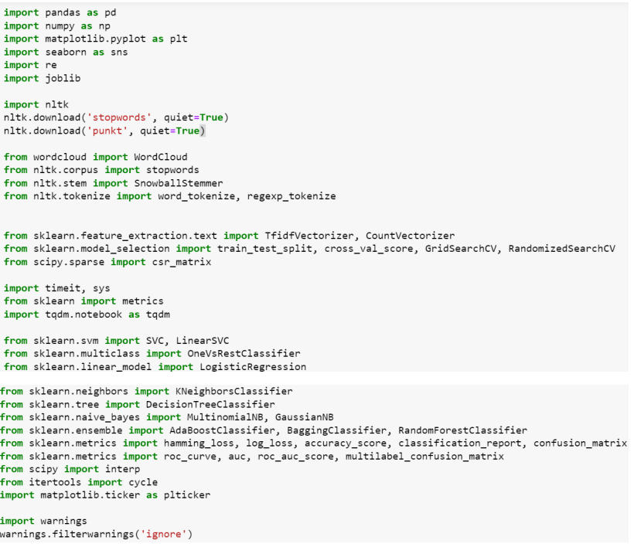
Imported Libraries:

Slide 10
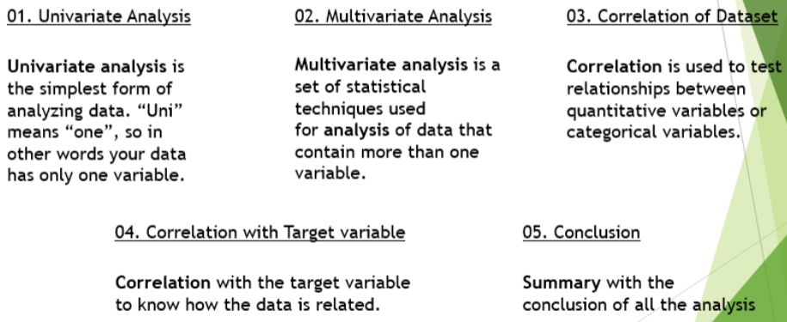
Exploratory Data Analysis(EDA) & Visualization

Slide 11
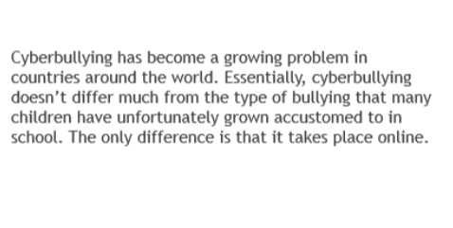
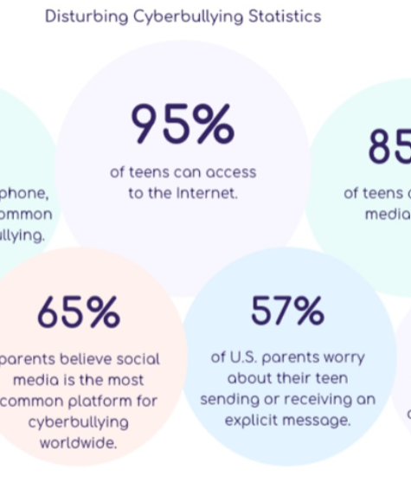
Cyber Bullying Statistics

Slide 12
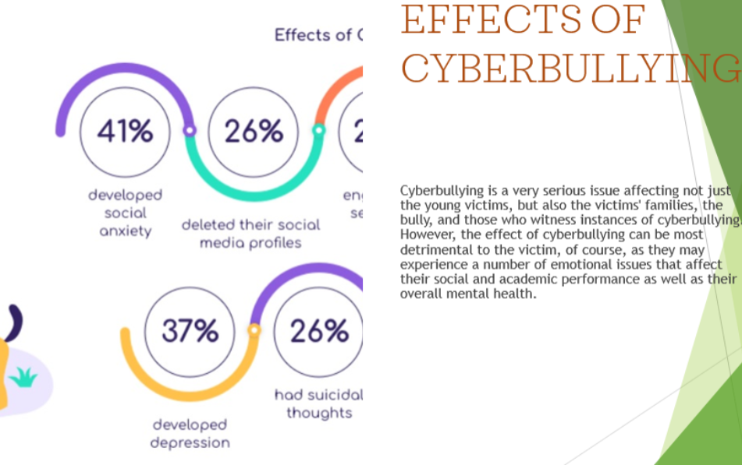

Slide 13
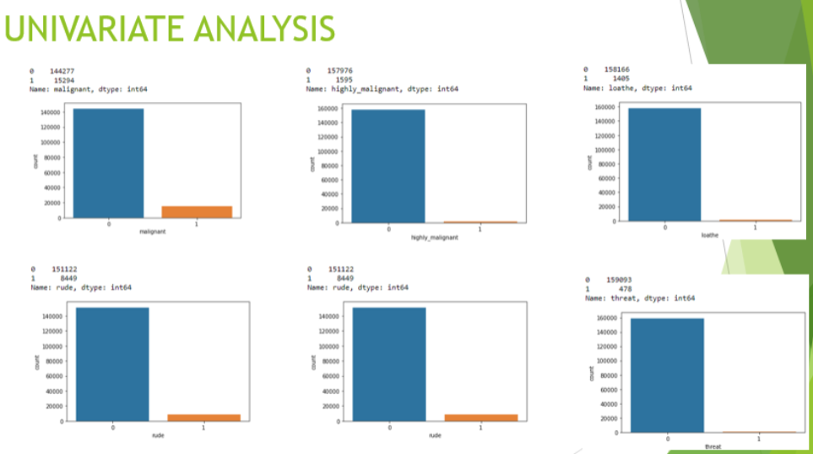

Slide 14
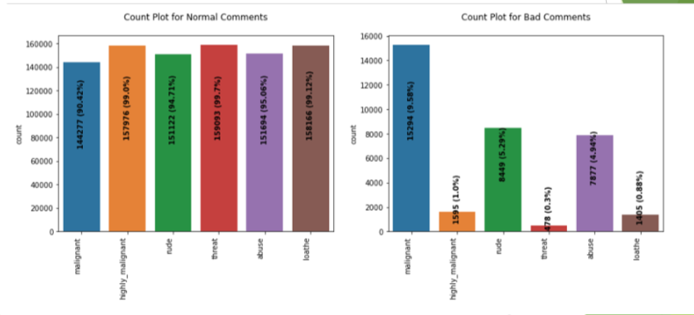
Univariate Analysis

Slide 15
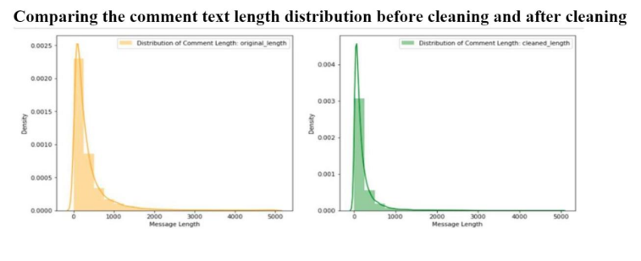
Distribution Plot

Slide 16
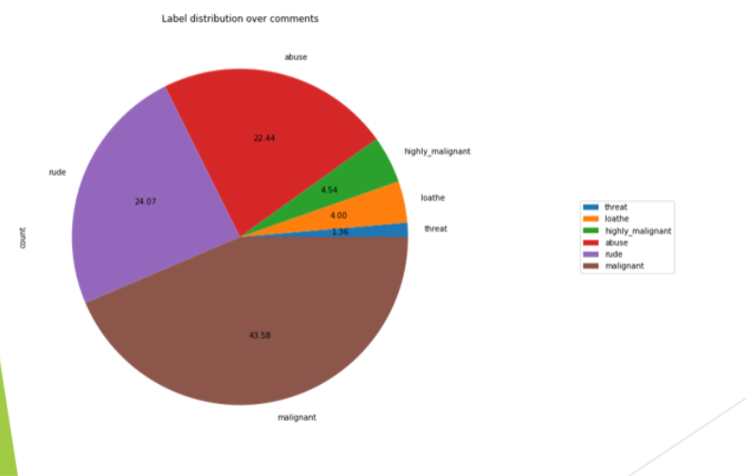
PIE PLOT

Slide 17
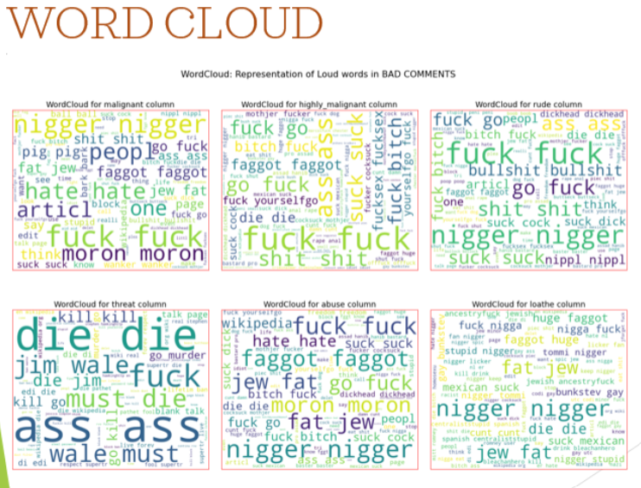

Slide 18
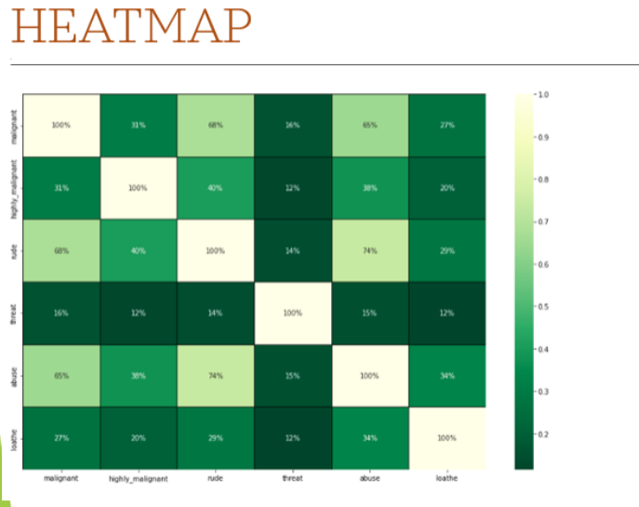

Slide 19
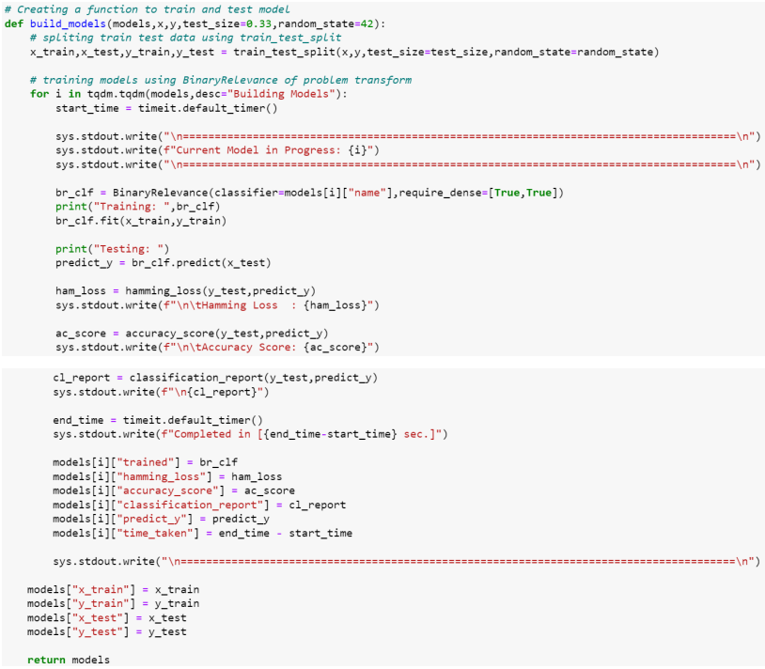
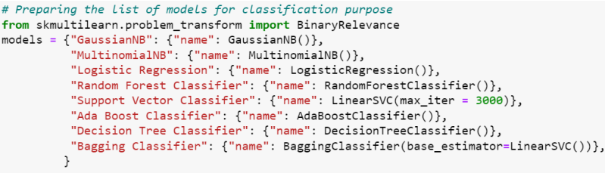
Classification Function

Slide 20
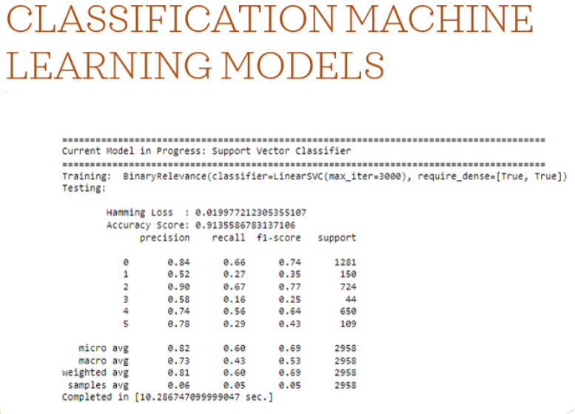

Slide 21
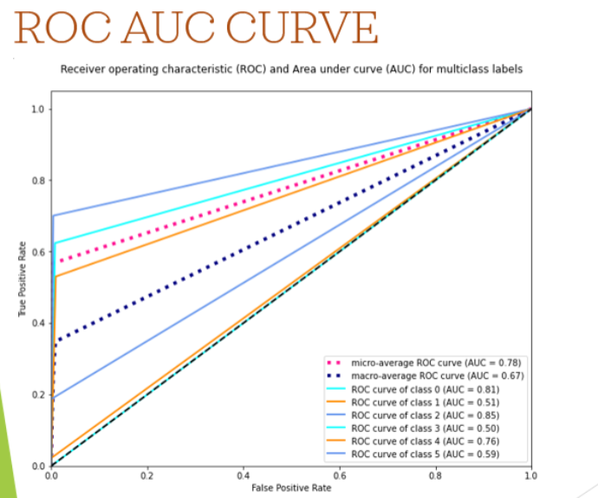

Slide 22
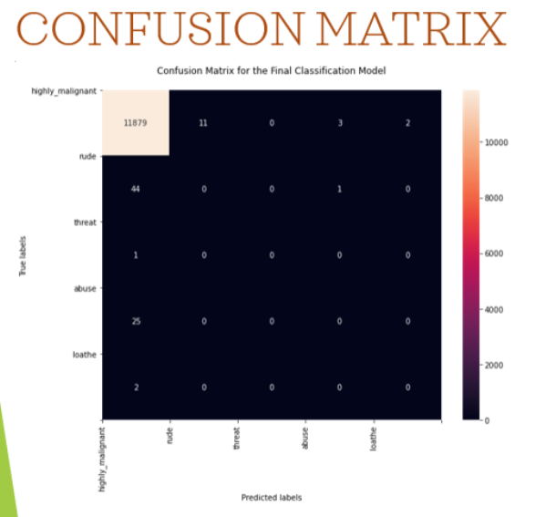

Slide 23
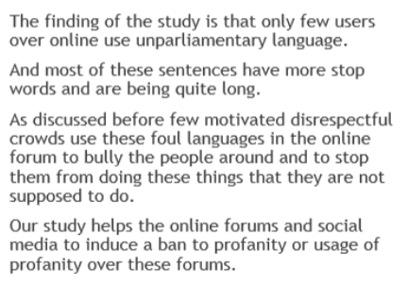
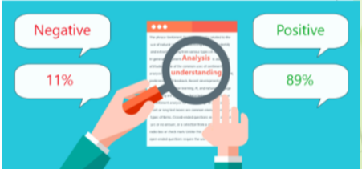
KEY FINDINGS AND CONCLUSION OF THE STUDY

Slide 24
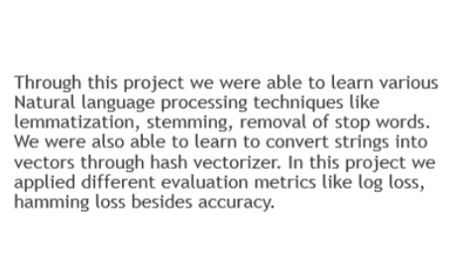
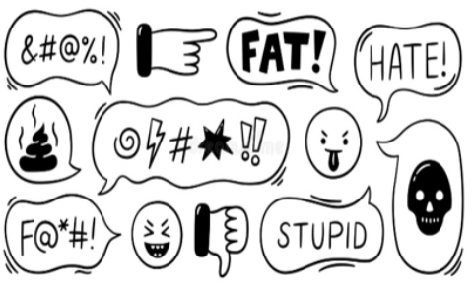
LEARNING OUTCOMES OF THE STUDY IN RESPECT OF DATASCIENCE

Slide 25
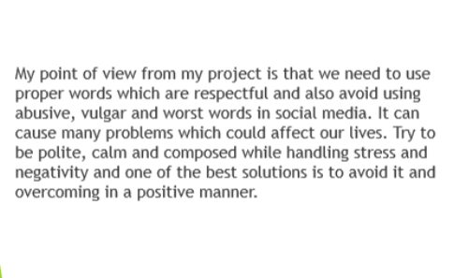

Learning Outcomes of The Study In Respect Of Data Science

Slide 26
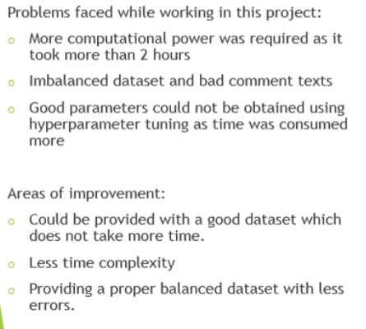
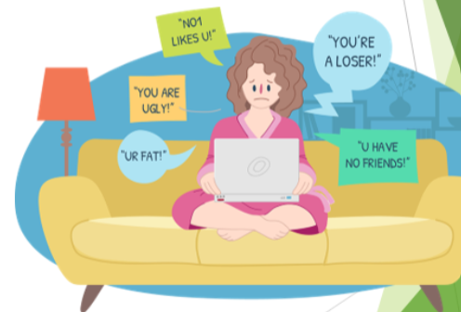
Limitations of This Work And Scope For Future Work

Slide 27


